Slide 1
Polypharmacology:
Combination therapy vs multitarget drug
Presented by
Randa Elshawadfy
Notes:
randa

Slide 2
Introduction
Single vs combination therapy
Combination therapy vs multitarget drug
Drug promiscuity, problems and solutions

Slide 3

Single therapy vs combination therapy
Single therapy | Combination therapy
More drug resistance Less effective | Continuous blocking of the target More effective disease control
Image from http://www.express.co.uk/life-style/health/319140/New-drug-mix-to-tackle-diabetes
Notes:
More side effects and tissue toxicity
Drug resistance is the reduction in effectiveness of a drug
Combination drug : specific drug combinations , Acting on same target or Acting on different pathways

Slide 4
Successful combination therapy
Diabetes mellitus type 2 disease
Combination therapy
Metformin: Decreases intestinal absorption of glucose
Glitazone: Improve insulin sensitivity
Insulin secretagogues: Increase insulin production
Failure of Single metformin therapy
Notes:
Diabetes mellitus type 2 , high sugar levels due to your body does not use insulin properly. This is called insulin resistance
3 drugs

Slide 5
Unsuccessful combination therapy
Drug for inflammation
Drug for neurons protection/repair
Higher efficiency
Multiple sclerosis Disease
Problem
Side effects of individual drugs were additive
Drugs interfered with each other
Notes:
MS), a complex central nervous system (CNS) inflammatory Disease, is a demyelinating disease in which the insulating covers of nerve cells in the brain and spinal cordare damaged
Less effective combination therapy
However, the advantages of
combination therapy in MS are still a matter of debate, as
adverse effects of individual drugs can be additive or even
synergistic, and drugs might interfere with each other, thereby
reducing efficacy.
debate if combination therapy is better for MS patients

Slide 6
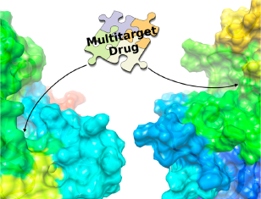
Define polypharmacology
Design of multitarget drug
Is multitarget drug more efficient than combination therapy?

Slide 7
Combination therapy vs multitarget drug
Combination therapy | Multitarget drugs
More drug-drug interaction Dosing schedule Combinations of different companies drugs | More effective in advanced stage disease More safety profile
Notes:
Dosing schedule which negatively impacts patient compliance
-In addition to the principal considerations above, problems may also arise when two drugs that are candidates for combination therapy are being developed by different pharma companies because regulatory and intellectual property issues may delay clinical trials of these investigational drug combinations.
Multitarget drug
A molecule that acts simultaneously on multiple targets often shows superior efficacy against advanced-stage diseases, compared to compounds with high specificity for a single target.
-single molecule with dual activity may have a more predictable pharmacokinetic profile (absorption, distribution, metabo- lism, and excretion)compared to multiple molecules administered in combination. Therefore, it may display a superior pharmacokinetic (PK) and safety profile
-Experience is showing that acute and delayed toxicities may be higher in drug combinations, especially when combining drugs that are not particularly selective.

Slide 8
Drug promiscuity
Balance between beneficial polypharmacology and harmful promiscuity of drugs
Problem:
Targets and off-targets with similar homology
Notes:
Could multitarget ligands be inherently more prone to side effects and adverse reactions? Adverse reactions are a major concern for drug safety
Challenging situations arise when primary and antitargets share significant homology because it will be harder to achieve the desired selectivity in cases where primary and antitargets are closely related.

Slide 9
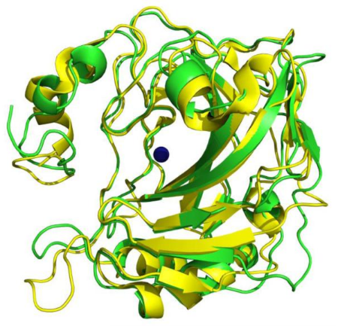
Example for similar homology
Carbonic anhydrase IX (CA IX in green)
Carbonic anhydrase II (CA II in yellow)
Very similar 3D structure
CA IX target for cancer therapy
CA II may cause many side effects
Image from https://www.ncbi.nlm.nih.gov/pmc/articles/PMC3593968/figure/F2/
Notes:
Share 31% sequence identity
CA II inhibition may cause a series of relevant adverse reactions such as constipation, diarrhea, eye irritation, watering, blurred vision, and taste changes
In this case, a difference of only three residues in the active site has been identified as a key feature exploitable for selectivity.

Slide 10
Activity against off-targets solutions
Screening of drugs against proteins
Predictive models

Slide 11
First: Screening of drugs
Problem:
Size of human proteome
Partial understanding of functional regions
Post-translational modifications
Notes:
Screening of drugs against proteins that are known to mediate SE
it is important to note that the size of the human proteome and the only partial understanding of its functional spectrum do currently not permit complete, or even nearly complete, off-target screening.

Slide 12
Second: Predictive models
Known drug-target and drug-side effects data
Predicts new drug-side effects relations
Notes:
drug used to treat migraine targeting serotonin receptors 5-HT-1B and 5- HT-1D, is responsible for increased pain sensitivity (hyperesthesia) as a consequence of binding to the off-target 5-HT-7 (26% sequence identity with 5-HT-1B and 5-HT-1D).

Slide 13
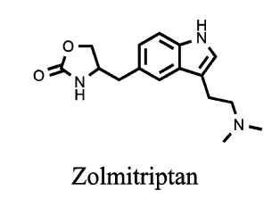
Example
Zolmitriptan target serotonin receptors 5-HT-1B and 5-HT-1D
Predict off-target serotonin receptor 5-HT-7 binding
5-HT-7 has 26% sequence identity with 5-HT-1B and 5-HT-1D
Increase pain sensitivity
Notes:
drug used to treat migraine targeting serotonin receptors 5-HT-1B and 5- HT-1D, is responsible for increased pain sensitivity (hyperesthesia) as a consequence of binding to the off-target 5-HT-7 (26% sequence identity with 5-HT-1B and 5-HT-1D).

Slide 14
Conclusion
Multitarget drug is more efficient than combination therapy
Target and off-target similar homology may leads to activity towards off-targets
Predictive models to overcome similar homology problem
Notes:
Similar homology of target and off-targets leads to activity against off-targets

Slide 15
References
Andrew Anighoro, Jürgen Bajorath and Giulio Rastelli: Polypharmacology: Challenges and Opportunities in Drug Discovery
Frank Lavernia,Sarag E.Adkins & Jaz H.Shubrook: Use of oral combination therapy for type 2 diabetes in primary care

Slide 16
Thank you for your attention

